Slide 1
Hudson County CIACC
(County Inter-Agency Coordinating Council)
In collaboration with the Department of Children and Families (DCF), the County Inter-Agency Coordinating Council (CIACC) strives to ensure a seamless array of services.
The CIACC serves as the county mechanism to advise the DCF on the development and maintenance of a responsive, accessible, and integrated system of care for children, youth and young adults with emotional and behavioral challenges and their families, through the involvement of parents, children, youth and young adults, child-serving agencies, and community representatives.
Through enhanced coordination of system partners, the CIACC also identifies service and resource gaps and priorities for resource development.

Slide 2

Children’s System of Care
Collaborating to Serve the Children and Families of New Jersey

Slide 3
NJ Department of Children and Families
New Jersey Department of Children and Families
Commissioner
Children’s System of Care
(formerly DCBHS)
Division of
Child Protection & Permanency
(formerly DYFS)
Division of
Family
& Community
Partnerships
(formerly DPCP)
Division on Women
Office of Adolescent Services
3
3
Notes:
3
Office on Advocacy, Education, Licensing, Performance Management and Accountability, Child Welfare Training Academy, and Institutional Abuse Investigation Unit

Slide 4


CSOC Mission
DCF’s Division of Children's
System of Care (CSOC) serves
children and adolescents with
emotional and behavioral
health care challenges and
their families; and children with developmental
disabilities. CSOC is committed to
providing these services based on the
needs of the child and family in a
family-centered, community-based
environment.
4
Notes:
4

Slide 5
Children’s System of Care Values and Principles
Accessible
Unconditional Care
Accountable
Team Based
Collaborative
VALUES:
Strengths Based
Comprehensive
Child Centered & Family Driven
Community Based
Culturally Competent
Promoting
Independence
Cost Effective
Family Involvement
Outcome Based
Needs Driven
Flexible
Home, School & Community Based
Individualized
5
Notes:
5
5

Slide 6



Children’s System of Care Objectives
We want to keep kids…
At Home
(with their families and not in out-of-home treatment settings)
In School
(in their regular school in their school district)
In the Community
(and not involved with the Juvenile Justice System or at risk of detention or incarceration)
6
6
Notes:
6

Slide 7
Key Components
CSA
PerformCare is the Contracted Systems Administrator for CSOC - Single portal for access to care
CMO
A care management organization that serves children, youth, young adults and their families/caregivers with high and moderate level of care coordination needs
FSO
Family-led support for CMO involved families, community education, warm lines, advocacy
MRSS
Crisis planning for youth with behavioral/emotional needs, available 24/7/365
7
7
Notes:
7

Slide 8
PerformCare is Contracted Systems Administrator (CSA) for CSOC
PerformCare functions as the single point of access for youth
into the Children’s System of Care.
CSA authorizes services, based on the most recent clinical information that is submitted to them.
CSA does not provide direct services.
  Anyone helping children and families may contact PerformCare on behalf of a youth in need of a referral. However, the parent/legal guardian of the youth must give consent for services.
  1-877-652-7624
CSA responsibilities include:
    Providing 24-hour/day, 7 days/week availability.
    Coordinating access to services for all eligible youth.
    Helping youth obtain any necessary specialized behavioral health services and / or services for the intellectually / developmental disabled.
    Supporting the CSOC goals of promoting best practices and assisting the state in assuring compliance with state and federal guidelines.
    Offering complaint, reconsideration, and appeal processes.
8

Slide 9
Appropriate Referrals to CSOC
At this time, referral to Perform Care is not required for outpatient services, such outpatient counseling, psychiatric evaluations / medication monitoring, anger management, etc. NJ MentalHealthCares maintains a thorough directory of services and can be accessed
by visiting njmentalhealthcares.org
or calling 866-202-HELP.
CSOC Care Management Services are high-level, time-limited, clinical service coordination programs, as opposed to a generic case management service that might offer assistance with job seeking, benefit application, etc. CMO is not needed to access outpatient services.
9

Slide 10


The Role of Assessment within CSOC
The vision of CSOC is to create positive outcomes for children with emotional and behavioral needs by:
Positive
Outcomes
  Identifying the child and family’s needs
Appropriate
Length of Stay
  Determining the most appropriate Intensity of Service
Appropriate
Services
  Delivering the most appropriate services
  for the most appropriate length of time
Appropriate
Intensity of Service
Child and
Family Needs
Using standard assessment tools –
the foundation of the Children’s
System of Care.
Assessment
Tools
10
10
Notes:
10

Slide 11
Children’s Mobile Response &
Stabilization Services
CMRSS
Are provided to youth who exhibit emotional or behavioral challenges that may jeopardize their current living situation
Provide face-to-face crisis response within one hour of notification

Slide 12
CMRSS
The goal is to stabilize behavior and prevent loss of ability to remain in home
Mobile Response is available 24 hour/day, 7 days/week
Can offer up to 8 weeks of stabilization services.
Access through Perform Care:
1-877-652-7624

Slide 13
Psychiatric ER Services
Notes:
13

Slide 14

Children’s Mobile Crisis Outreach
Crisis Outreach to Schools
Child Team Specialist
Telephone Consultation/Intervention
On Site Assessment
Referral Information
Follow Up Services
Family Support for Caregiver

Slide 15

Care Management Organization
(CMO)
Hudson Partnership CMO
Intensive, long term, team based care management
Community Based
Child-Family Team, Individualized Service plan
Focus on Family Strengths & Needs

Slide 16
Wraparound IS . . .
not a program
or
a service
. . . a process
and an approach.
The Wraparound Process is as simple as people helping people
Notes:
16

Slide 17
Family Centered
Families having access, voice and choice at every stage of the planning process

Slide 18

Strengths As Strategies

Slide 19

Strengths as Strategies
Focus on strengths and needs
Not family deficit centered
Identify & Incorporate Community and Natural/Informal Resources
Strategies made as a team
with and for the family unit
using the Wraparound concept

Slide 20

Formal Services
Local Mental Heath Providers
Behavioral Assistance
In Community Services
Family Centered
Culturally Competent
Coordinated Services
Out Patient Services

Slide 21
Natural / Informal Supports and Community Resources
Friends, Family, Peers
Place of Worship
Civic & Ethnic Organizations
Community Support Groups
Neighborhood Resources i.e.; Boys/Girls clubs, YMCA, Big Brothers/Big Sisters

Slide 22
Hudson County System of Care
FAMILY
DCP&P
Mobile
Response
CIACC
Care
Management
Organization
Family
Support
Organization
Youth
Partnership
Providers
Schools
Family Court

Slide 23
Referring a Youth to OOH Treatment
CMO Role
The youth’s Child Family Team must have determined that a referral to OOH treatment is warranted (This step is completed by DCP&P, in cases of a Telephonic Review).
Care Managers have no legal authority to start OOH referral process without parental permission or court order. It is critical that they have up-to-date contact information.
Care Managers must gather and submit updated clinical information to PerformCare for Intensity of Service (IOS) determination.
23
Notes:
23
Care management entities cannot start the out of home process with parental consent or a court order.

Slide 24

Family Support Organization
(FSO)
Non-Profit
Parent-Peer Support
Support Groups
Warm Line
Education
Training
Advocacy
Youth Partnership
Website:
www.njalliance-fso.org
201-915-5140

Slide 25
Benefits of the FSO
Same training courses as CMO workers
Understanding- we have a child with emotional, behavioral, mental and/or physical health challenges
Knowledgeable across Multiple Systems
Wraparound and support the family
Empower the family with support, education and advocacy training
We Travel, serving ALL of Hudson County
We can accept outside or self referrals (Warm Line)
Support the Youth Partnership of Hudson County

Slide 26
Our Mission
Working in partnership with families, children and other professionals to identify strengths, needs and appropriate resources, as well as providing community-based family support, education and advocacy for families that have children with emotional, behavioral or mental health challenges.

Slide 27
The Way Forward:
Becoming a Comprehensive Child and Family Service Agency
27

Slide 28
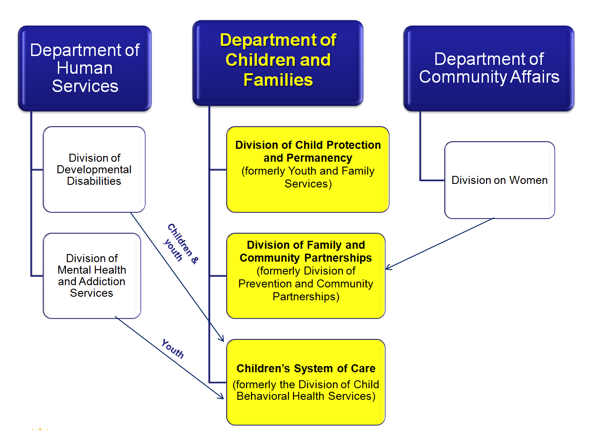
28

Slide 29

Children’s System of Care
Supporting children with developmental disabilities
  Single point of entry and enhanced access to needed services
  Responsive to the whole child and the whole family
  Synchronized service coordination; elimination of duplicated services
29
Notes:
29

Slide 30
Children’s System of Care
Intellectual / Developmental Disabilities
Service Coordination
  CSOC has reconfigured the way service coordination will take place
    CSOC is providing a 24 hour/7 day a week resources through PerformCare to assess needs and facilitate the delivery of services
    CSOC has a state-of-the-art information management system that was not available prior to January 1, 2013
    This information management system is managed by PerformCare and will significantly help to manage a child's care over time
    Case Management
    CMO Care Managers will coordinate services for youth determined eligible for CMO services
    DCPP Case Managers will coordinate services for youth in their care when CMO is not involved
    CSOC DD Consultants will coordinate services children with very intense service needs and no CMO or DCPP involvement
30
Notes:
30

Slide 31

DD Eligibility Determination
CSOC Criteria:
  Under the age of 18
  New Jersey resident
  Functional Criteria – DD
  US citizen or lawful permanent resident
Notes:
31

Slide 32
Support for Youth with Developmental Disabilities
Below age 21
– DCF Children’s System of Care
Age 21 and older
– DHS Division of Developmental Disabilities

Slide 33
Children’s System of Care
Substance Abuse Services for Children and Adolescents
As of July 1, 2013, PerformCare began to authorize youth, who meet specific criteria to receive substance use treatment services, for 15 service providers who are contracted with the Children’s System of Care. BPS with expanded Substance Abuse Module will be available mid August.
33
Notes:
33

Slide 34
Children’s System of Care
Substance Abuse Services for Children and Adolescents
Who is eligible?
Currently, the services managed by PerformCare are limited to youth ages 13 up until their 18th birthday who meet clinical criteria for substance abuse treatment.
Other means of available funding, including private insurance or county funding, should be exhausted prior to seeking substance abuse services through PerformCare.
Youth can be referred by the Division of Child Protection & Permanency (DCP&P), Juvenile Court (identified Court/Probation agents), designated county substance abuse coordinators, Mobile Response & Stabilization Services (MRSS), Care Management Organizations (CMO), or one of the contracted 15 substance abuse provider agencies.
Families and youth may also contact us directly to confirm their eligibility for services
34
Notes:
34

Slide 35
Children’s System of Care
Substance Abuse Services for Children and Adolescents
What type of substance use treatment services are authorized through PerformCare?
Outpatient
Intensive Outpatient
Partial Care
Short-Term Residential
Long-Term Residential
All services are authorized based on clinical criteria
35
Notes:
35

Slide 36
Substance Abuse Services for
Children and Adolescents
Residential Providers: Short and Long Term
Agency | County
Bonnie Brae | Somerset
Daytop | Morris / Salem
Integrity House | Essex
Newark Renaissance House | Essex
New Hope | Monmouth
Straight & Narrow | Passaic / Hudson
Vantage | Bergen
36
Notes:
36

Slide 37
Substance Abuse Services for
Children and Adolescents
Outpatient Providers
Agency | County
Catholic Charities | Burlington, Mercer, Monmouth
COPE | Essex
CPC Behavioral Health, Inc. | Monmouth
Family Connections | Essex
Father’s House | Camden
Genesis Counseling | Camden
Seashore Family Services | Ocean
SODAT | Gloucester, Atlantic, Burlington, Camden, Cumberland, Salem
37
Notes:
37

Slide 38
Problem Solving for CSOC Court-involved Youth
Issues Regarding:
Contact:
Treatment Service Provider
Case Management Entity
Specific Youth
Care Manager
Supervisor
Clinical Director
Executive Director/CEO
(For DCP&P involved youth, be sure to contact and coordinate with assigned DCPP Case Worker.)
Mike Higginbotham, LCSW
Liaison to the Judiciary michael.higginbotham@dcf.state.nj.us
System Issues
38
38

Slide 39
Glossary of Acronyms and Terms
ABS-HSRS (Adaptive Behavior/Health/Safety/Risk Summary ) – A tool intended to capture information that accurately reflects an individual’s functional abilities and health, safety and/or risk concerns. It can be used for an individual applying for DDD eligibility or as necessary for an individual who is eligible to receive DDD services. It should be completed by someone who knows the individual, such as a family member, caregiver or case manager.
ASAM (American Society of Addiction Medicine) – ASAM is the most widely used and comprehensive set of guidelines for treatment, continued stay, and transfer/discharge of individuals with addiction and co-occurring conditions.
CSA (Contracted System Administrator - PerformCare) - An administrative organization contracted by DCF - CSOC to provide utilization management, care coordination, quality management, and information management for the Children’s System of Care that provides mental and/or behavioral health services and supports to eligible children, youth, and young adults.
CSOC (Children’s System of Care) - The Division within DCF that serves children and adolescents with emotional and behavioral health care challenges and their families; and children with developmental disabilities.
CYBER (Child Youth Behavioral Health Electronic Record) is a fully functional, multi-system electronic medical record. The protected health information (PHI) contained in CYBER is protected by HIPAA regulations and should be accessed only on a need to know basis. Please review HIPAA regulations and address any questions with your supervisor to ensure compliance.
39

Slide 40
Glossary of Acronyms and Terms
DCF (Department of Children and Families) - The Department that includes the Children’s System of Care (CSOC), Division of Children Protection and Permanency (DCP&P), and the Division of Family and Community Partnerships (DFCP).
DD (Developmental Disability) – Is attributable to a mental or physical impairment or combination of mental or physical impairments; manifests before 22 years of age; is likely to continue indefinitely; causes substantial functional limitations in at least three of the following life activities: self-care, communication, learning, mobility, self-direction, capacity for independent living, and economic self-sufficiency; reflects the need for care, treatment, or other services, which are of lifelong or extended duration and are individually planned and coordinated.
IOS (Intensity of Service) – Frequency, intensity, and duration of treatment services.
OOH – Out-of-Home treatment.
SRTU - Specialized Residential Treatment Unit is a part of CSOC. It works toward quality OOH programming and provides consultation to case managers for youth determined to be in need of SPEC IOS, PCH IOS, and Special Needs Homes.
Youth Link – The technology in CYBER by which both case managers and OOH treatment providers manage referrals, admissions, and discharges. It is a dynamic real-time process.
40

Slide 41
For more information…
41
41
1
Children’s System of Care
http://www.state.nj.us/dcf/providers/csc/
PerformCare Member Services: 877-652-7624
www.performcarenj.org

Slide 42
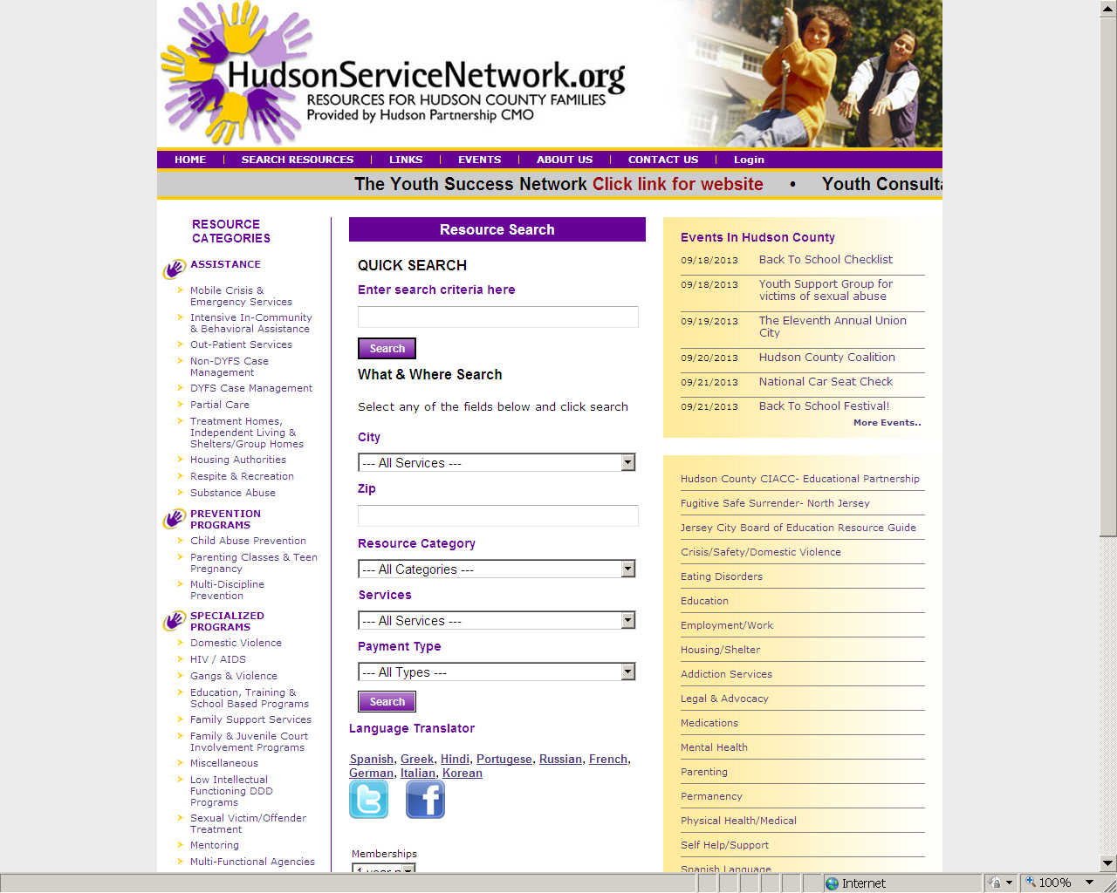

Slide 43
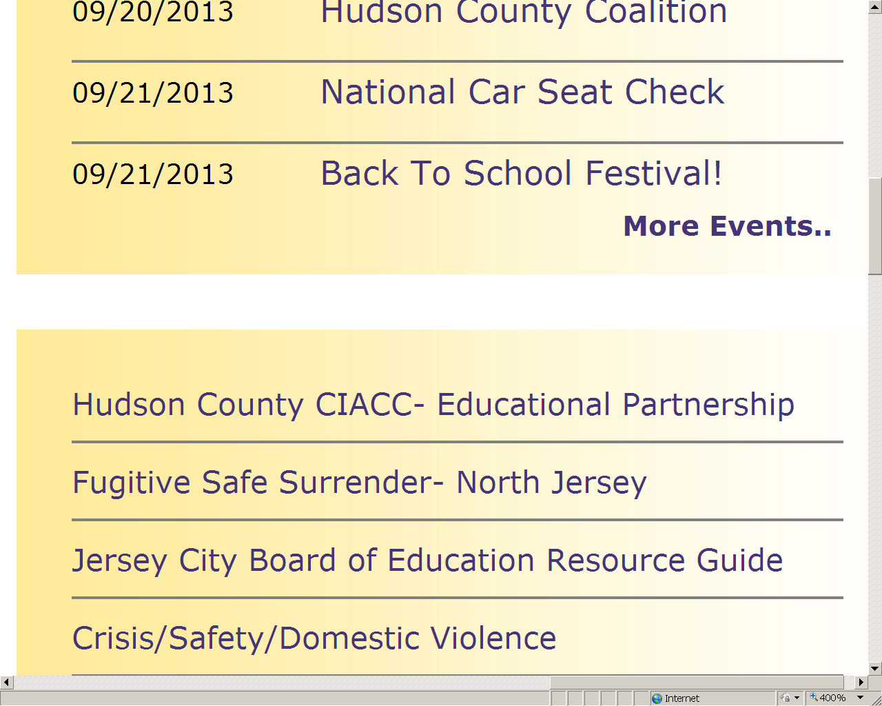

Slide 44
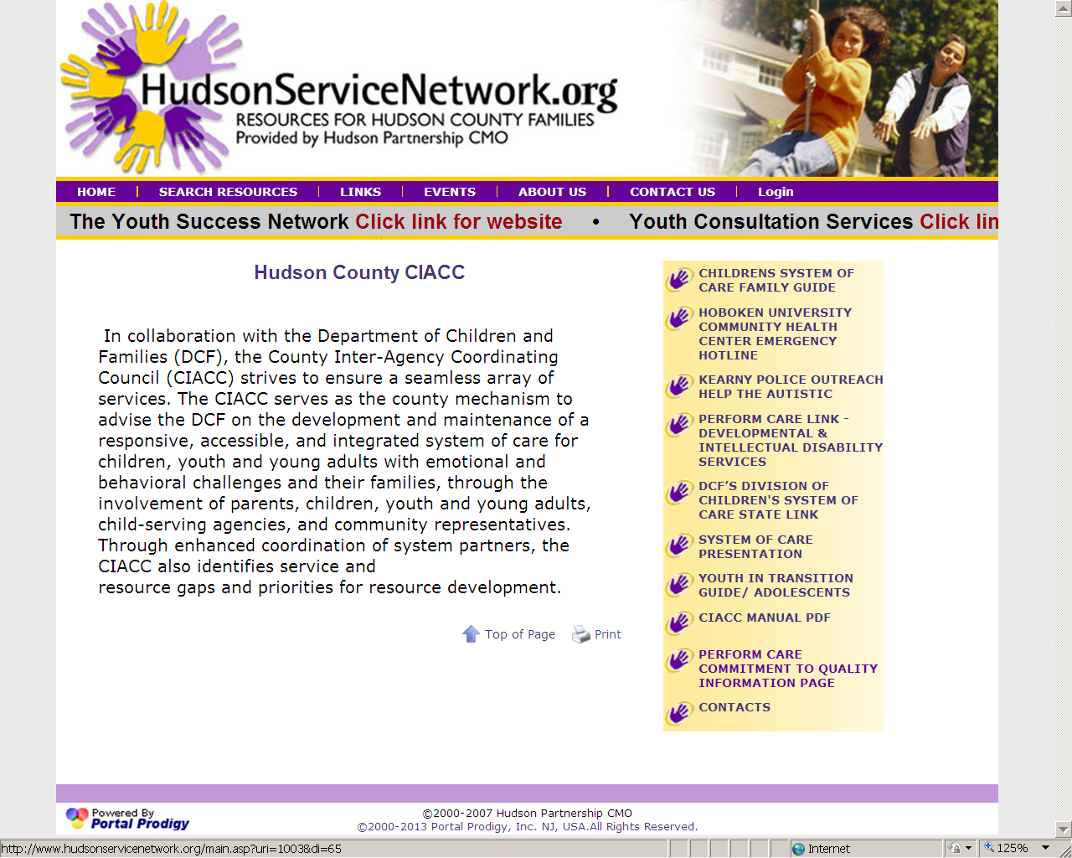

Slide 45
Contact Us
Perform Care 1-877-652-7624
Mobile Response , CMRSS
Patricia Valdivia, LCSW 201-798-7452
Hudson Partnership CMO
Steven Campos 201 537 1429
  Hudsonservicenetwork.org
Family Partners Hudson County FSO&
Youth Partnership of Hudson County
  Gloria Rivera 201-915-5140
  CIACC Coordinator
  Phone: 201-369-5280 ext. 4238

