Slide 1
The Hudson Partnership:
Community for Youth Crime Prevention and Educational Partnership
1st Community Partnership Meeting

Slide 2
Vision
To create a wrap-around community partnership that will collaborate to address the needs of at risk/court involved youth ages 13-21 from the highest crime areas in Jersey City
The goal will be to reduce involvement with the juvenile justice system by increasing community and educational bonds

Slide 3
Breakdown
What is the Children’s System of Care
What does the CMO do?
What is JDAI? Juvenile Detention Alternatives Initiative
Let’s talk about our Jersey City youth
How do we prevent youth involvement in the Juvenile Justice System?
By working Together!

Slide 4

Children’s System of Care
Collaborating to Serve the Children and Families of New Jersey

Slide 5



Children’s System of Care Objectives
We want to keep kids…
At Home
(with their families and not in out-of-home treatment settings)
In School
(in their regular school in their school district)
In the Community
(and not involved with the Juvenile Justice System or at risk of detention or incarceration)
5
5
Notes:
5

Slide 6
Key Components
CSA
PerformCare is the Contracted Systems Administrator for CSOC - Single portal for access to care
CMO
A care management organization that serves children, youth, young adults and their families/caregivers with high and moderate level of care coordination needs
FSO
Family-led support for CMO involved families, community education, warm lines, advocacy
MRSS
Crisis planning for youth with behavioral/emotional needs, available 24/7/365
6
6
Notes:
6

Slide 7
PerformCare is Contracted Systems Administrator (CSA) for CSOC
PerformCare functions as the single point of access for youth
into the Children’s System of Care.
CSA authorizes services, based on the most recent clinical information that is submitted to them.
CSA does not provide direct services.
  Anyone helping children and families may contact PerformCare on behalf of a youth in need of a referral. However, the parent/legal guardian of the youth must give consent for services.
  1-877-652-7624
CSA responsibilities include:
    Providing 24-hour/day, 7 days/week availability.
    Coordinating access to services for all eligible youth.
    Helping youth obtain any necessary specialized behavioral health services and / or services for the intellectually / developmental disabled.
    Supporting the CSOC goals of promoting best practices and assisting the state in assuring compliance with state and federal guidelines.
    Offering complaint, reconsideration, and appeal processes.
7

Slide 8
Wraparound IS . . .
not a program
or
a service
. . . a process
and an approach.
The Wraparound Process is as simple as people helping people
Notes:
8

Slide 9

Family Centered
Families having access, voice and choice at every stage of the planning process

Slide 10

Formal Services
Local Mental Heath Providers
Behavioral Assistance
In Community Services
Family Centered
Culturally Competent
Coordinated Services
Out Patient Services

Slide 11

Natural / Informal Supports and Community Resources
Friends, Family, Peers
Place of Worship
Civic & Ethnic Organizations
Community Support Groups
Neighborhood Resources i.e.; Boys/Girls clubs, YMCA, Big Brothers/Big Sisters

Slide 12

Family Support Organization
(FSO)
Non-Profit
Parent-Peer Support
Support Groups
Warm Line
Education
Training
Advocacy
Youth Partnership
Website:
www.njalliance-fso.org
201-915-5140

Slide 13
Contact Us
Perform Care 1-877-652-7624
  Mobile Response
  Hudson Partnership CMO - 201 537 1429 Steven Campos
  Hudsonservicenetwork.org or scampos@hudsoncmo.org
Family Partners Hudson County FSO&
Youth Partnership of Hudson County
  Gloria Rivera 201-915-5140

Slide 14
New jersey juvenile justice reform
JDAI
Emily Fox ■ JJC Research & Reform Specialist ■ May 29, 2014 ■ Jersey City Community Partnership Meeting

Slide 15
Presentation overview
Genesis of JDAI in NJ.
JDAI objectives and 8 core strategies.
Status of JDAI in Hudson County.
Community Outreach Subcommittee.
Why Greenville and Bergen-Lafayette?
Q&A discussion.

Slide 16



Genesis of jdai in new jersey
Juvenile Arrests
Detention
ADP
1993 – 2002
1996
2002
37.7%
24.7%
Overcrowded facilities operated at
122% - 223% capacity.

Slide 17
What is the purpose of detention?
The “objective of detention is to provide secure custody for those juveniles who are deemed a threat to the physical safety of the community and/or whose confinement is necessary to insure their presence at the next court hearing” (N.J.A.C. 13:92-1.3).
Notes:
The purpose of secure detention is to ensure alleged delinquents appear at scheduled court hearings and to minimize the risk of serious reoffending while youth await the disposition of their cases. And so the appropriate and necessary use of detention would be for these purposes only. This is especially important because research has shown to us that detention is the last place we want to put a kid unless we really have to.

Slide 18
What are the dangers of detention?
Detention doesn’t work as a deterrent (the greatest predictor of recidivism is prior incarceration)
Congregating delinquent youth together negatively affects their behavior and increases their chances of reoffending
Detained youth are more likely to get deeper involved in the justice system
There is little relationship between detention and community crime rates
Detention can slow or disrupt the natural process of “aging out of delinquency”
Detention makes mentally ill children worse
Detained special needs children often don’t return to school
Detention is expensive and not cost-effective
Notes:
It is worth noting that 100% of kids will be released from detention and so the effects of detention on these children will play out not only in their lives but in ours and our community’s as well. So what are the dangers of detention? Number one, detention doesn’t work as a deterrent. In fact, the greatest predictor of recidivism in prior incarceration, a better predictor than gang involvement, poor parental relationships, or the carrying of a weapon. 2) Getting a whole bunch of delinquent youth together in a place where they can never leave negatively affects their behavior and increases their chances of reoffending. This is especially troubling if you consider that we were (and often still are) housing youth charged with serious, violent offenses alongside kids who have low-level theft or drug offenses. 3) Detained youth are more likely to adjudicated delinquent and have a formal record and detained are three time more likely to be sentenced to a term of incarceration than youth charged with similar offenses who have not been detained. 4) There is little relationship between detention rates and community crime rates, locking up kids doesn’t seem to make us any safer 5) Most kids, as you know because you’ve been one, age out of a lot stupid and delinquent behavior. Most kids stop offending on their own between the ages of 16 and 20 with no intervention. Detaining them can disrupt or slow this process. 6) Detention is often an unhealthy, unstable environment and kids with mental health needs suffer in those environments. One study even suggested that the transition into incarceration itself may be responsible for some of the observed depression of kids in detention. 7) On average, across the country, 43% of children receiving remedial education in detention, never returned to school. 8) Detention costs money. A lot of it. Usually, about 10 to 15 times what it costs to run an alternative supervision program based in the community. And the return? Pretty awful, if detention is the best predictor of recidivism. So we know who should be in detention, the most serious offenders who threaten our community and the kids who have a history of not appearing for court. We also know what our kids face when they are put into secure detention. This lays the foundation for JDAI.

Slide 19
Jdai – what is the objective?
The purpose of JDAI is to demonstrate that sites can safely reduce reliance on secure detention, with the objective to:
Eliminate the inappropriate or unnecessary use of secure detention;
Minimize re-arrest and failure-to-appear rates pending adjudication;
Ensure appropriate conditions of confinement in secure facilities;
Redirect public finances to sustain successful reforms; and
Reduce racial and ethnic disparities.

Slide 20
Jdai 8 core strategies
Local sites/counties pursue eight interrelated core strategies to accomplish the JDAI objectives.
Collaboration and leadership;
Use of accurate data;
Objective admissions criteria and instruments;
New or enhanced non-secure alternatives to detention;
Case processing reforms;
Special detention cases;
Reducing racial disparities; and
Improving conditions of confinement.

Slide 21
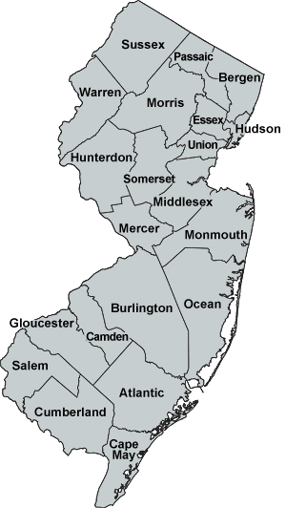
New jersey as a “model state”
As of 2013, 16 counties were actively participating in JDAI.
Atlantic
Camden
Essex
Hudson
Monmouth
Bergen
Burlington
Mercer
Ocean
Union
Passaic
Somerset
Middlesex
Cumberland
Warren
Gloucester

Slide 22

Hudson county jdai work
In 2013 there were:
  778 fewer youth admitted to detention than in the year prior to JDAI implementation
  More than 56 fewer youth in detention on any given day when compared to the year prior to JDAI

Slide 23
Hudson county jdai structure
Hudson County Council on Juvenile Justice System Improvement
Probation Subcommittee
Case Processing Subcommittee
Conditions of Confinement Subcommittee
Community Outreach Subcommittee
Representation from:
Juvenile Judges
Public Defenders
Prosecutors
Family Court Staff
NJ Juvenile Justice Commission
Hudson Partnership (CMO)
Probation
Detention center Staff
Hudson County Dept. of Corrections
Dept. of Children & Families

Slide 24

Community outreach subcommittee
Formed Community Outreach Subcommittee because we know doing this work means building relationships with community partners…
WHO?

Slide 25
Why Jersey city?
Jersey City kids make up about 37% of the youth population in Hudson County
But make up over 60% of Hudson’s admissions to detention

Slide 26
Why Greenville and bergen-lafayette?
In 2013, kids from Greenville and Bergen-Lafayette made up 71% of the Jersey City youth admitted to detention
and made up 43% of all Hudson County admissions to detention

Slide 27
Hudson Partnership Youth
Total Court involved Youth from Greenville and Bergen Lafayette: 54
Total Youth in Detention: 7 out of 20
Total Youth in residential placement: 8

Slide 28
Vision
To create a wrap-around community partnership that will collaborate to address the needs of at risk/court involved youth ages 13-21 from the highest crime areas in Jersey City
The goal will be to reduce involvement with the juvenile justice system by increasing community and educational bonds

Slide 29
The needs and Wrap-around
Areas of Need:
Education
Exposure to violence
Perception of safety in the community
More…..
Wraparound/Care Managers
Strength based
Builds Teams that speaks to needs
Collaboration
Support System for the youth and family
Community!!
Creates one comprehensive plan that involves/community and partners
Youth accountability

Slide 30
We need the Community
We need a network of supporting partners and informal supports that can speak to the needs of our youth
We need to connect families to providers, community programs and positive supportive people ( more team members)
Families will be provided information and education
Train and work together
Child and Family Team meetings with increased attendance

Slide 31
The Details, the how
Identify, cultivate community partnerships (meetings, events, education, interventions)
Identify youth (target Population)
Referral forms ( Care Managers)
HIPPA forms ( confidentiality and release of information)
Connect families to providers, community programs and positive supportive people ( more team members)
Families will be provided information, education and support
Train and work together
Child and Family Team meetings
AWARNESS!
Policy!

Slide 32
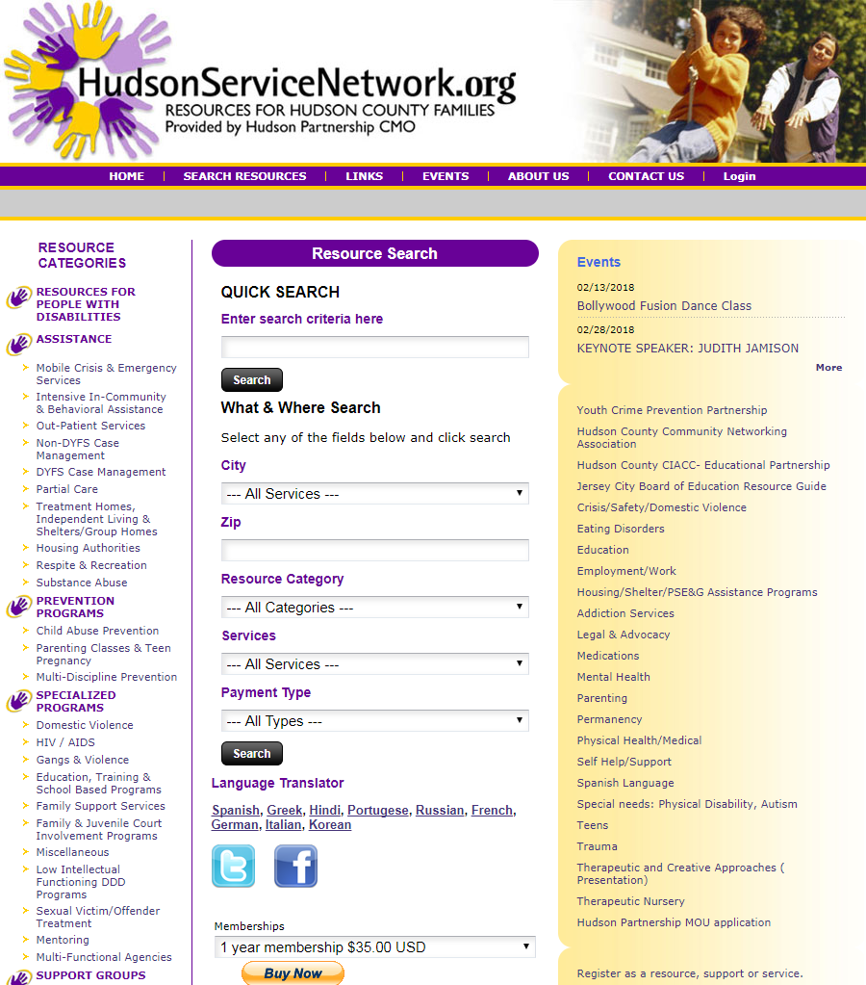

Slide 33
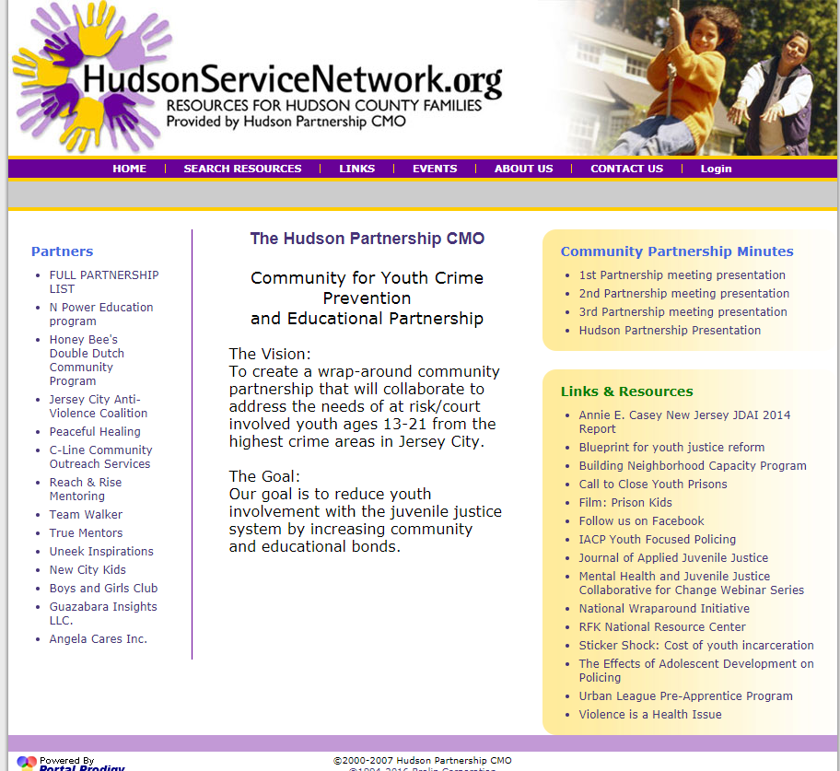

Slide 34
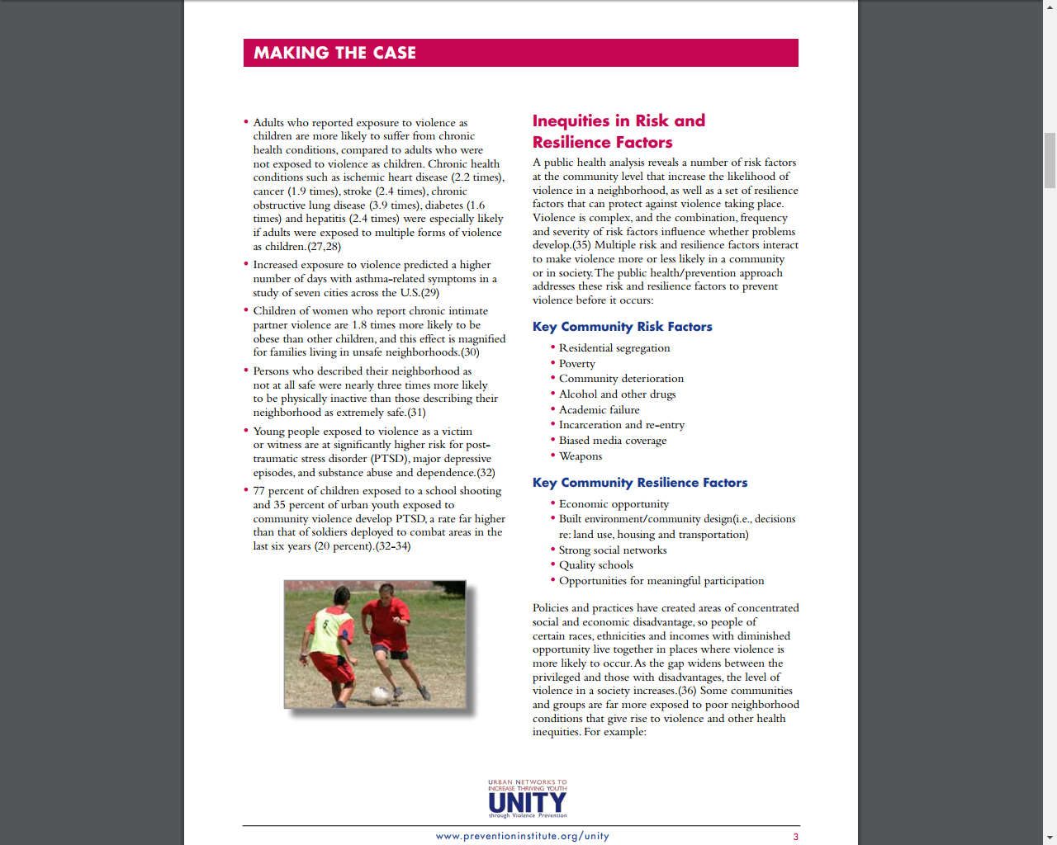

Slide 36

Q & A
Courtnie Thomas
Juvenile Justice Commission
JDAI Research and Reform Specialist
Steven Campos
Hudson Partnership CMO
Community Resource Director
scampos@hudsoncmo.org
got questions?

