Slide 1

Children’s System of Care
Collaborating to Serve the Children and Families of New Jersey
(Crisis Planning)

Slide 2


CSOC Mission
DCF’s Division of Children's
System of Care (CSOC) serves
children and adolescents with
emotional and behavioral
health care challenges and
their families; and children with developmental
disabilities. CSOC is committed to
providing these services based on the
needs of the child and family in a
family-centered, community-based
environment.
2
Notes:
2

Slide 3
Children’s System of Care Values and Principles
Accessible
Unconditional Care
Accountable
Team Based
Collaborative
VALUES:
Strengths Based
Comprehensive
Child Centered & Family Driven
Community Based
Culturally Competent
Promoting
Independence
Cost Effective
Family Involvement
Outcome Based
Needs Driven
Flexible
Home, School & Community Based
Individualized
3
Notes:
3
3

Slide 4



Children’s System of Care Objectives
We want to keep kids…
At Home
(with their families and not in out-of-home treatment settings)
In School
(in their regular school in their school district)
In the Community
(and not involved with the Juvenile Justice System or at risk of detention or incarceration)
4
4
Notes:
4

Slide 5
Key Components
CSA
PerformCare is the Contracted Systems Administrator for CSOC - Single portal for access to care
CMO
A care management organization that serves children, youth, young adults and their families/caregivers with high and moderate level of care coordination needs
FSO
Family-led support for CMO involved families, community education, warm lines, advocacy
MRSS
Crisis planning for youth with behavioral/emotional needs, available 24/7/365
5
5
Notes:
5

Slide 6
NJ Department of Children and Families
Hudson County Children’s System of Care
Schools
PerformCare
FSO
MRSS
CMO
Intensive In Community (IIC)-Behavioral Assistance (BA)
Community Supports
Intensive In Home (IIH) – Individual Support Services (ISS) –ABA services
Schools
6
6
Notes:
6
Office on Advocacy, Education, Licensing, Performance Management and Accountability, Child Welfare Training Academy, and Institutional Abuse Investigation Unit

Slide 7
Wraparound IS . . .
not a program
or
a service
. . . a process
and an approach.
The Wraparound Process is as simple as people helping people
Notes:
7

Slide 8

Family Centered
Families having access, voice and choice at every stage of the planning process

Slide 9

Strengths as Strategies
Focus on strengths and needs
Not family deficit centered
Identify & Incorporate Community and Natural/Informal Resources
Strategies made as a team
with and for the family unit
using the Wraparound concept

Slide 10
PerformCare is Contracted Systems Administrator (CSA) for CSOC
PerformCare functions as the single point of access for youth
into the Children’s System of Care.
CSA authorizes services, based on the most recent clinical information that is submitted to them.
CSA does not provide direct services.
  Anyone helping children and families may contact PerformCare on behalf of a youth in need of a referral. However, the parent/legal guardian of the youth must give consent for services.
  1-877-652-7624
CSA responsibilities include:
    Providing 24-hour/day, 7 days/week availability.
    Coordinating access to services for all eligible youth.
    Helping youth obtain any necessary specialized behavioral health services and / or services for the intellectually / developmental disabled.
    Supporting the CSOC goals of promoting best practices and assisting the state in assuring compliance with state and federal guidelines.
    Offering complaint, reconsideration, and appeal processes.
10

Slide 11
Catholic Charities
Mobile Response
The goal is to stabilize behavior and prevent loss of ability to remain in home
Mobile Response is available 24 hour/day, 7 days/week
Can offer up to 8 weeks of stabilization services.
Access through Perform Care:1-877-652-7624
Program Director- Patricia Valdivia Office: 201-798-7452

Slide 12

Care Management Organization
(CMO)
Hudson Partnership CMO
Intensive, long term, team based care management
Community Based
Child-Family Team, Individualized Service plan
Focus on Family Strengths & Needs
Office 201 537 1460
Chief Operations Officer-Anthony Cameli ext.421

Slide 13

Hudson Partnership CMO
Crisis Planning
Family crisis definition
Family strengths/interest
Triggers
Strategies-Reactive
Who can help-names/phone numbers
Family and caregiver support
Follow up-revisit crisis plan

Slide 14

Family Support Organization
(FSO)
Non-Profit
Parent-Peer Support
Support Groups
Warm Line
Education
Training
Advocacy
Youth Partnership
Website:
www.njalliance-fso.org
201-915-5140

Slide 15


The YouthSuccessNetwork
Since 2003, The Youth Success Network, a New Jersey Licensed Provider of Mental and Behavioral Healthcare, has been serving the Youth and families of New Jersey
Crisis Planning and Involvement
Behavioral Assistance/ Intensive In-Community Counseling
  Youth: Focused and Structured Behavioral Healthcare
  Parent: Focused and Structured Parent Behavioral Management Training
  (coping skills, management skills, de-escalation skills, motivational skills)
Truancy Prevention Program (in collaboration with Jersey City Truancy Court and the JCBOE)
  Clinical and Therapeutic approach to addressing Truancy and Absenteeism
Jersey City Public Schools → Member of the Inter-Agency Task Force
For more information please contact:
Junie Jean-Marie 888-897-6465 jjeanmarie@tysn.org
David Ishibashi 201-731-3728 dishibashi@tysn.org

Slide 16

Cooperative Counseling Services
Nurtured Heart Approach
In home Clinicians
Behavioral Assistant
Jim Kimberling, MSW, LSW
Director of H/R & Development
Advanced Trainer – Nurtured Heart Approach
Cooperative Counseling Services
T: (908) 731-7099 ext. 307
F: (908) 731-7102
www.cooperativecs.com
Intensive In Community (IIC)-Behavioral Assistance (BA)

Slide 17

Intensive In Home (IIH) – Individual Support Services (ISS) –ABA services
Provide weekly therapeutic services within the home setting to youth with intellectual and/or developmental disabilities.
Provide education and instruction to parents/caregivers.
Services are intended to be brief (2-12 months) and are typically authorized at 2-4 hours per week.
ISS addresses adaptive behavior and skill development for activities of daily living (ADLs)
Bret Vaks
Executive Director
Autism Family Services of New Jersey
An Affiliate of The Family Resource Network
bvaks@autismfamilyservicesnj.org

Slide 18
Credentials & Requirements
All IIH Clinical providers are required to be licensed (LSW, LAC, LCSW, LPC, LMFT)
All IIH Clinical providers are required to be approved by CSOC prior to working with this population.
All IIH Clinical providers are required to have at minimum, 1 year of providing clinical services to youth with I/DD.
Must have a TB test & criminal background check. Most providers are CPR certified.

Slide 19
Levels of ISS
Level 1 Technician:
    responsible for creating the plan and providing supervision of the plan.
    BA/BS degree
    At least 1 year creating individual service plans
Level 2 Technician:
    responsible for implementing the plan
    BA/BS degree
    At least 1 year implementing individual service plans
Level 3 Technician:
    responsible for implementing the plan.
    HS/GED level
    At least 3 years implementing individual service plans

Slide 20
Intensive In Home (IIH) – Individual Support Services (ISS) –ABA services
Provide weekly therapeutic services within the home setting to youth with intellectual and/or developmental disabilities.
Provide education and instruction to parents/caregivers.
Services are intended to be brief (2-12 months) and are typically authorized at 2-4 hours per week.
ISS addresses adaptive behavior and skill development for activities of daily living (ADLs)
Valerie Rawls, LCSW
CEO/Clinical Director
TeamUP Counseling, LLC
Main Office: (201) 292-3475
Cell: (201) 725-3613
Fax: (201) 328-9404
Website: http://www.teamupcounseling.com/

Slide 21


Intensive In Home (IIH) – Individual Support Services (ISS) –ABA services
Services Offered/ Youth Served
Crisis Planning
Community Transition Planning
Bret Vaks
Executive Director
Autism Family Services of New Jersey
An Affiliate of The Family Resource Network
bvaks@autismfamilyservicesnj.org

Slide 22
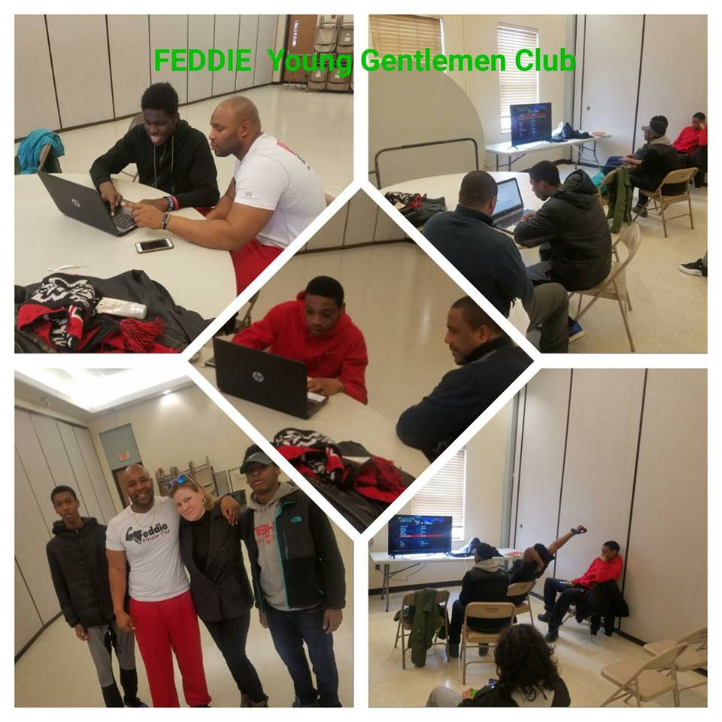
COMMUNITY
F.E.D.D.I.E- Fortitude For Every Disadvantaged Demographic Investing in Excellence
Referrals from the community via friends and family
Honesty is key/Communication
Its not what you say but how you say it.
Letting kids know you genuinely care is essential.

Slide 23

COMMUNITY
F.E.D.D.I.E-
I Am You
Having general conversation, try to identify who you both know in common
Understanding their language, way of communication, and their perspective on life
Thinking like a kid
Avoiding being judgmental

Slide 24
Understanding our youth
Family relationships and friendships
Does the child have their father/positive male role model active in their life? Active being more than just Monterey compensation or only around to discipline.
Family structure, whose raising the child? Grandparents, just one parent, or both parents.
What are the status of their older siblings
Having general conversation, try to identify who you both know in common
Understanding their language, way of communication, and their perspective on life
Thinking like a kid/ Avoid being judgmental
Image maintenance / image management

Slide 25

Natural / Informal Supports and Community Resources
Friends, Family, Peers
Place of Worship
Civic & Ethnic Organizations
Community Support Groups
Neighborhood Resources i.e.; Boys/Girls clubs, YMCA, Big Brothers/Big Sisters

Slide 26
Hudson County System of Care
FAMILY
DCP&P
Mobile
Response
Community Programs/Groups
Care
Management
Organization
Family
Support
Organization
Youth
Partnership
Providers
Schools
Family Court

Slide 27
The Way Forward:
Becoming a Comprehensive Child and Family Service Agency
27

Slide 28
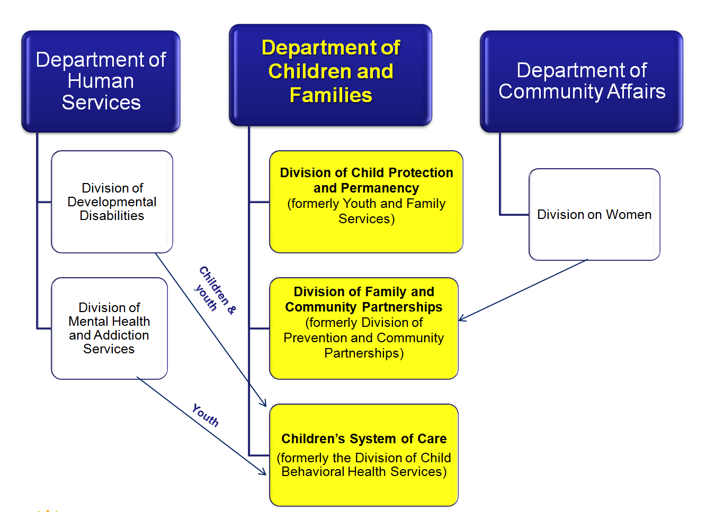
28

Slide 29

DD Eligibility Determination
CSOC Criteria:
  Under the age of 18
  New Jersey resident
  Functional Criteria – DD
  US citizen or lawful permanent resident
Notes:
29

Slide 30
Support for Youth with Developmental Disabilities
Below age 21
– DCF Children’s System of Care
Age 21 and older
– DHS Division of Developmental Disabilities

Slide 31

Children’s System of Care
Substance Abuse Services for Children and Adolescents
As of July 1, 2013, PerformCare began to authorize youth, who meet specific criteria to receive substance use treatment services, for 15 service providers who are contracted with the Children’s System of Care. BPS with expanded Substance Abuse Module will be available mid August.
31
Notes:
31

Slide 32
Substance Abuse Services for
Children and Adolescents
Residential Providers: Short and Long Term
Agency | County
Bonnie Brae | Somerset
Daytop | Morris / Salem
Integrity House | Essex
Newark Renaissance House | Essex
New Hope | Monmouth
Straight & Narrow | Passaic / Hudson
Vantage | Bergen
32
Notes:
32

Slide 33
Substance Abuse Services for
Children and Adolescents
Outpatient Providers
Agency | County
Catholic Charities | Burlington, Mercer, Monmouth
COPE | Essex
CPC Behavioral Health, Inc. | Monmouth
Family Connections | Essex
Father’s House | Camden
Genesis Counseling | Camden
Seashore Family Services | Ocean
SODAT | Gloucester, Atlantic, Burlington, Camden, Cumberland, Salem
33
Notes:
33

Slide 34
For more information…
34
34
1
Children’s System of Care
http://www.state.nj.us/dcf/providers/csc/
PerformCare Member Services: 877-652-7624
www.performcarenj.org

Slide 35
Hudson County CIACC
(County Inter-Agency Coordinating Council)
In collaboration with the Department of Children and Families (DCF), the County Inter-Agency Coordinating Council (CIACC) strives to ensure a seamless array of services.
The CIACC serves as the county mechanism to advise the DCF on the development and maintenance of a responsive, accessible, and integrated system of care for children, youth and young adults with emotional and behavioral challenges and their families, through the involvement of parents, children, youth and young adults, child-serving agencies, and community representatives.
Through enhanced coordination of system partners, the CIACC also identifies service and resource gaps and priorities for resource development.

Slide 36

HUDSON COUNTY DEPARTMENT OF HEALTH AND HUMAN SERVICES
CHILDREN’S INTERAGENCY COORDINATING COUNCIL (CIACC)
Convene monthly multi-disciplinary meeting to review and discuss the system of services for children with emotional, behavioral, mental and intellectually developmental challenges in their home community;
Present to schools and other organizations on the Children’s System of Care;
Identify and address barriers to effective service delivery;
Foster cross-system collaborations to better meet the needs of these children; and
Provides targeted training and services to children and families to help address their needs. Past activities have focused on crisis response in the school, community and home; youth social and emotional development; behavior management and de-escalation; minor sex trafficking prevention; bullying prevention and support for parents of children with developmental disabilities
2017 CIACC activities will focus on community violence prevention, trauma-informed care and transition to adulthood.

Slide 37
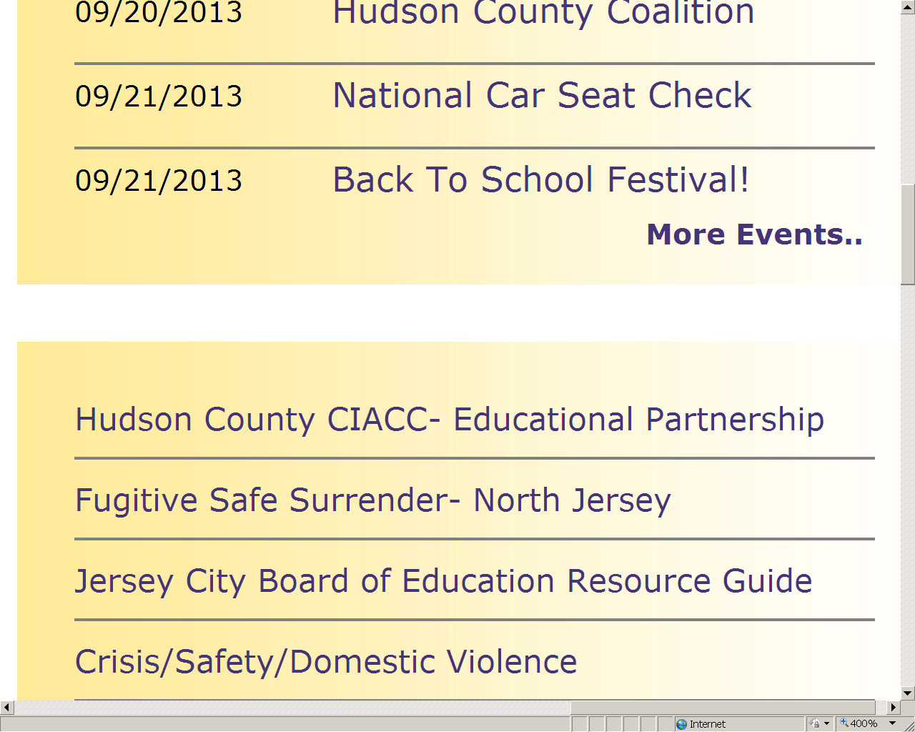

Slide 38
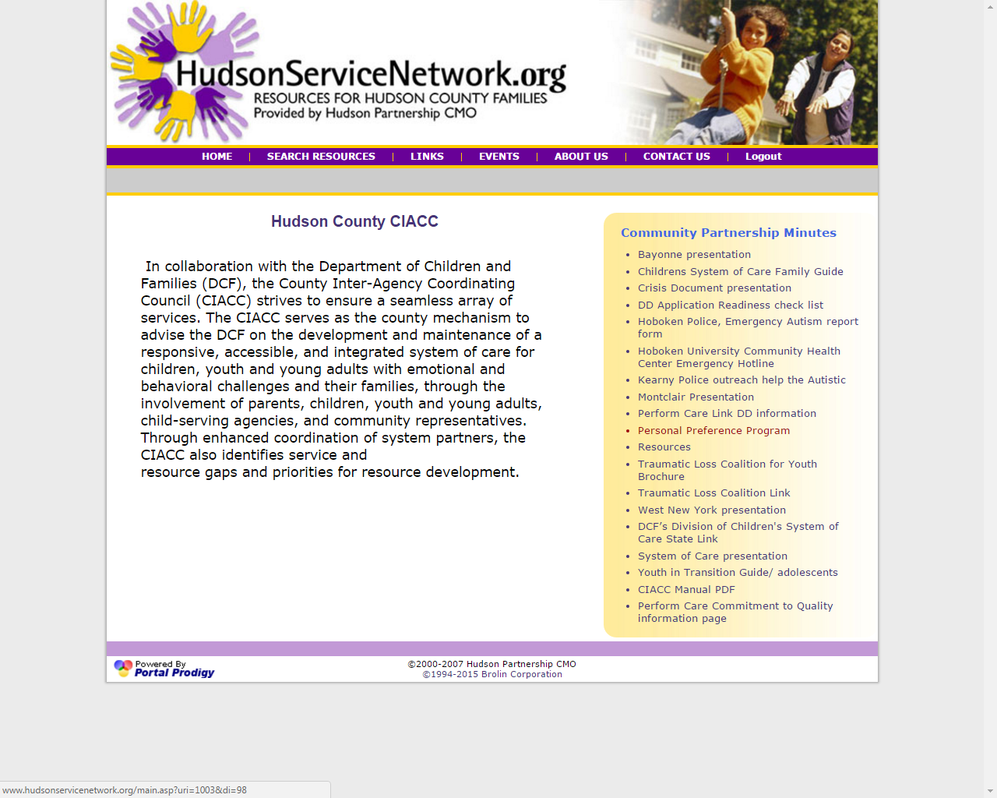

Slide 39
Resource Websites
  http://www.monmouthresourcenet.org/
  http://www.passaicresourcenet.org/
  http://www.tricountyresourcenet.org/
  http://www.oceanresourcenet.org/
  http://www.unionresourcenet.org/
  http://www.bergenresourcenet.org/
  http://www.burlingtonresourcenet.org/
  http://www.camdenresourcenet.org/
  http://www.cgsresourcenet.org/
  http://www.essexresourcenet.org/
  http://www.hudsonservicenetwork.org

