Slide 1

Children’s System of Care
Collaborating to Serve the Children and Families of New Jersey

Slide 2


CSOC Mission
DCF’s Division of Children's
System of Care (CSOC) serves
children and adolescents with
emotional and behavioral
health care challenges and
their families; and children with developmental
disabilities. CSOC is committed to
providing these services based on the
needs of the child and family in a
family-centered, community-based
environment.
2
Notes:
2

Slide 3



Children’s System of Care Objectives
We want to keep kids…
At Home
(with their families and not in out-of-home treatment settings)
In School
(in their regular school in their school district)
In the Community
(and not involved with the Juvenile Justice System or at risk of detention or incarceration)
3
3
Notes:
3

Slide 4
Key Components
CSA
PerformCare is the Contracted Systems Administrator for CSOC - Single portal for access to care
CMO
A care management organization that serves children, youth, young adults and their families/caregivers with high and moderate level of care coordination needs
FSO
Family-led support for CMO involved families, community education, warm lines, advocacy
MRSS
Crisis planning for youth with behavioral/emotional needs, available 24/7/365
4
4
Notes:
4

Slide 5
PerformCare is Contracted Systems Administrator (CSA) for CSOC
PerformCare functions as the single point of access for youth
into the Children’s System of Care.
CSA authorizes services, based on the most recent clinical information that is submitted to them.
CSA does not provide direct services.
  Anyone helping children and families may contact PerformCare on behalf of a youth in need of a referral. However, the parent/legal guardian of the youth must give consent for services.
  1-877-652-7624
CSA responsibilities include:
    Providing 24-hour/day, 7 days/week availability.
    Coordinating access to services for all eligible youth.
    Helping youth obtain any necessary specialized behavioral health services and / or services for the intellectually / developmental disabled.
    Supporting the CSOC goals of promoting best practices and assisting the state in assuring compliance with state and federal guidelines.
    Offering complaint, reconsideration, and appeal processes.
5

Slide 6
Children’s Mobile Response &
Stabilization Services
CMRSS
Are provided to youth who exhibit emotional or behavioral challenges that may jeopardize their current living situation
Provide face-to-face crisis response within one hour of notification

Slide 7
CMRSS
The goal is to stabilize behavior and prevent loss of ability to remain in home
Mobile Response is available 24 hour/day, 7 days/week
Can offer up to 8 weeks of stabilization services.
Access through Perform Care:
1-877-652-7624

Slide 8
Referrals
Schools advise parents to call Perform Care
Outpatient providers advise parents to call Perform Care
Community Groups help link to Perform Care
Courts refer youth directly via a 14 day plan request
Substance Abuse residential treatment youth referred directly
DD youth are screened by Perform Care

Slide 9

Care Management Organization
(CMO)
Hudson Partnership CMO
Intensive, long term, team based care management
Community Based
Child-Family Team, Individualized Service plan
Focus on Family Strengths & Needs

Slide 10

Formal Services
Local Mental Heath Providers
Behavioral Assistance
In Community Services
Family Centered
Culturally Competent
Coordinated Services
Out Patient Services

Slide 11

Natural / Informal Supports and Community Resources
Friends, Family, Peers
Place of Worship
Civic & Ethnic Organizations
Community Support Groups
Neighborhood Resources i.e.; Boys/Girls clubs, YMCA, Big Brothers/Big Sisters

Slide 12
Referring a Youth to OOH Treatment
CMO Role
The youth’s Child Family Team must have determined that a referral to OOH treatment is warranted (This step is completed by DCP&P, in cases of a Telephonic Review).
Care Managers have no legal authority to start OOH referral process without parental permission or court order. It is critical that they have up-to-date contact information.
Care Managers must gather and submit updated clinical information to PerformCare for Intensity of Service (IOS) determination.
12
Notes:
12
Care management entities cannot start the out of home process with parental consent or a court order.

Slide 13

Family Support Organization
(FSO)
Non-Profit
Parent-Peer Support
Support Groups
Warm Line
Education
Training
Advocacy
Youth Partnership
Website:
www.njalliance-fso.org
201-915-5140

Slide 14
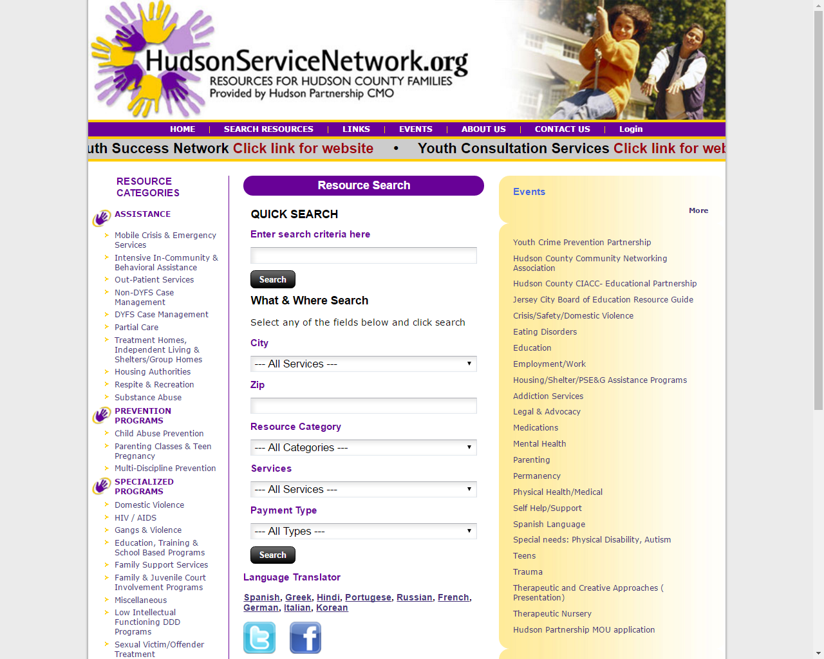

Slide 15


Slide 16
Community Empowerment
Message: You Matter to the Community
Caregivers
Family
Clinician
Teacher
Friends
Youth
Community
Partners
Police
Courts
At Risk Youth
Faith
Based
United Message
Communication
PLAN

Slide 17
Contact Us
Perform Care 1-877-652-7624 www.performcarenj.org
Mobile Response , CMRSS
Patricia Valdivia, LCSW 201-798-7452
Hudson Partnership CMO
Steven Campos 201 537 1429 scampos@hudsoncmo.org
Robyn Gorman 201 537 1412 rgorman@hudsoncmo.org
  Hudsonservicenetwork.org
Family Partners Hudson County FSO&
Youth Partnership of Hudson County
  Gloria Rivera 201-915-5140

