Slide 1

Children’s System of Care
Collaborating to Serve the Children and Families of New Jersey

Slide 2


CSOC Mission
DCF’s Division of Children's
System of Care (CSOC) serves
children and adolescents with
emotional and behavioral
health care challenges and
their families; and children with developmental
disabilities. CSOC is committed to
providing these services based on the
needs of the child and family in a
family-centered, community-based
environment.
2
Notes:
2

Slide 3



Children’s System of Care Objectives
We want to keep kids…
At Home
(with their families and not in out-of-home treatment settings)
In School
(in their regular school in their school district)
In the Community
(and not involved with the Juvenile Justice System or at risk of detention or incarceration)
3
3
Notes:
3

Slide 4
Key Components
CSA
PerformCare is the Contracted Systems Administrator for CSOC - Single portal for access to care
CMO
A care management organization that serves children, youth, young adults and their families/caregivers with high and moderate level of care coordination needs
FSO
Family-led support for CMO involved families, community education, warm lines, advocacy
MRSS
Crisis planning for youth with behavioral/emotional needs, available 24/7/365
4
4
Notes:
4

Slide 5
Hudson County CIACC
(County Inter-Agency Coordinating Council)
In collaboration with the Department of Children and Families (DCF), the County Inter-Agency Coordinating Council (CIACC) strives to ensure a seamless array of services.
The CIACC serves as the county mechanism to advise the DCF on the development and maintenance of a responsive, accessible, and integrated system of care for children, youth and young adults with emotional and behavioral challenges and their families, through the involvement of parents, children, youth and young adults, child-serving agencies, and community representatives.
Through enhanced coordination of system partners, the CIACC also identifies service and resource gaps and priorities for resource development.

Slide 6
PerformCare is Contracted Systems Administrator (CSA) for CSOC
PerformCare functions as the single point of access for youth
into the Children’s System of Care.
CSA authorizes services, based on the most recent clinical information that is submitted to them.
CSA does not provide direct services.
  Anyone helping children and families may contact PerformCare on behalf of a youth in need of a referral. However, the parent/legal guardian of the youth must give consent for services.
  1-877-652-7624
CSA responsibilities include:
    Providing 24-hour/day, 7 days/week availability.
    Coordinating access to services for all eligible youth.
    Helping youth obtain any necessary specialized behavioral health services and / or services for the intellectually / developmental disabled.
    Supporting the CSOC goals of promoting best practices and assisting the state in assuring compliance with state and federal guidelines.
    Offering complaint, reconsideration, and appeal processes.
6

Slide 7

DD Eligibility Determination
CSOC Criteria:
  Under the age of 18
  New Jersey resident
  Functional Criteria – DD
  US citizen or lawful permanent resident
Notes:
7

Slide 8
Expansion of Intensive In-Home Services (IIH)
Individual Support Services (ISS) beginning June 2015
New service added to the existing continuum of in- home services available to DD eligible youth

Slide 9


Slide 10
Community Collaboration
Message: We can help families by working together
Caregivers
Family
Clinician
Teacher
Friends
Youth
Community
Partners
Police
Families with
needs
United Message
Communication
PLAN

Slide 11

Children’s Mobile Crisis Outreach
Crisis Outreach to Schools
Child Team Specialist
Telephone Consultation/Intervention
On Site Assessment
Referral Information
Follow Up Services
Family Support for Caregiver

Slide 12

Care Management Organization
(CMO)
Hudson Partnership CMO
Intensive, long term, team based care management
Community Based
Child-Family Team, Individualized Service plan
Focus on Family Strengths & Needs

Slide 13

Formal Services
Local Mental Heath Providers
Behavioral Assistance
In Community Services
Family Centered
Culturally Competent
Coordinated Services
Out Patient Services

Slide 14

Natural / Informal Supports and Community Resources
Friends, Family, Peers
Place of Worship
Civic & Ethnic Organizations
Community Support Groups
Neighborhood Resources i.e.; Boys/Girls clubs, YMCA, Big Brothers/Big Sisters

Slide 15
Referring a Youth to OOH Treatment
CMO Role
The youth’s Child Family Team must have determined that a referral to OOH treatment is warranted (This step is completed by DCP&P, in cases of a Telephonic Review).
Care Managers have no legal authority to start OOH referral process without parental permission or court order. It is critical that they have up-to-date contact information.
Care Managers must gather and submit updated clinical information to PerformCare for Intensity of Service (IOS) determination.
15
Notes:
15
Care management entities cannot start the out of home process with parental consent or a court order.

Slide 16

Family Support Organization
(FSO)
Non-Profit
Parent-Peer Support
Support Groups
Warm Line
Education
Training
Advocacy
Youth Partnership
Website:
www.njalliance-fso.org
201-915-5140

Slide 17
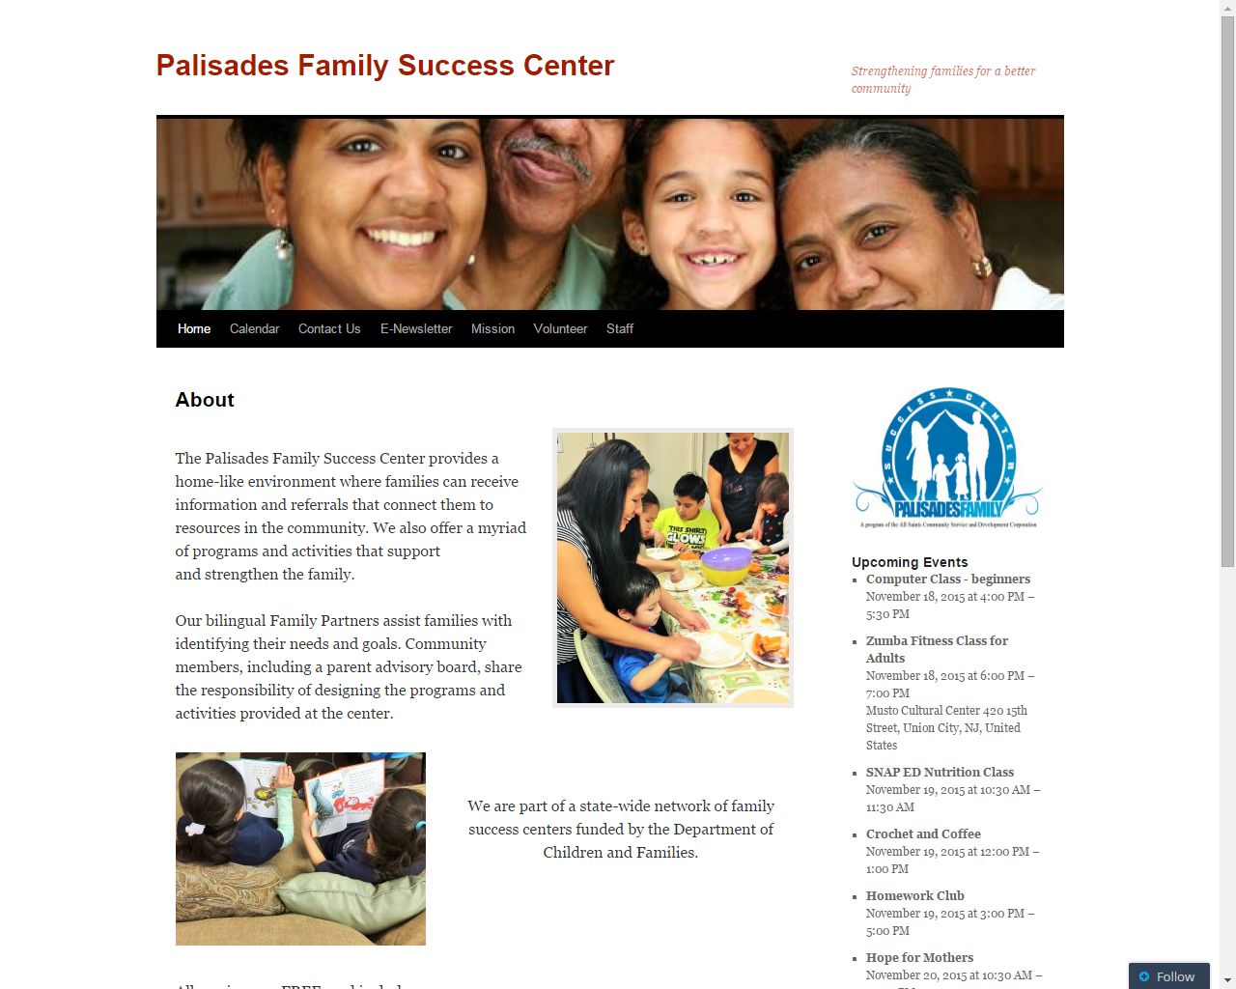

Slide 18
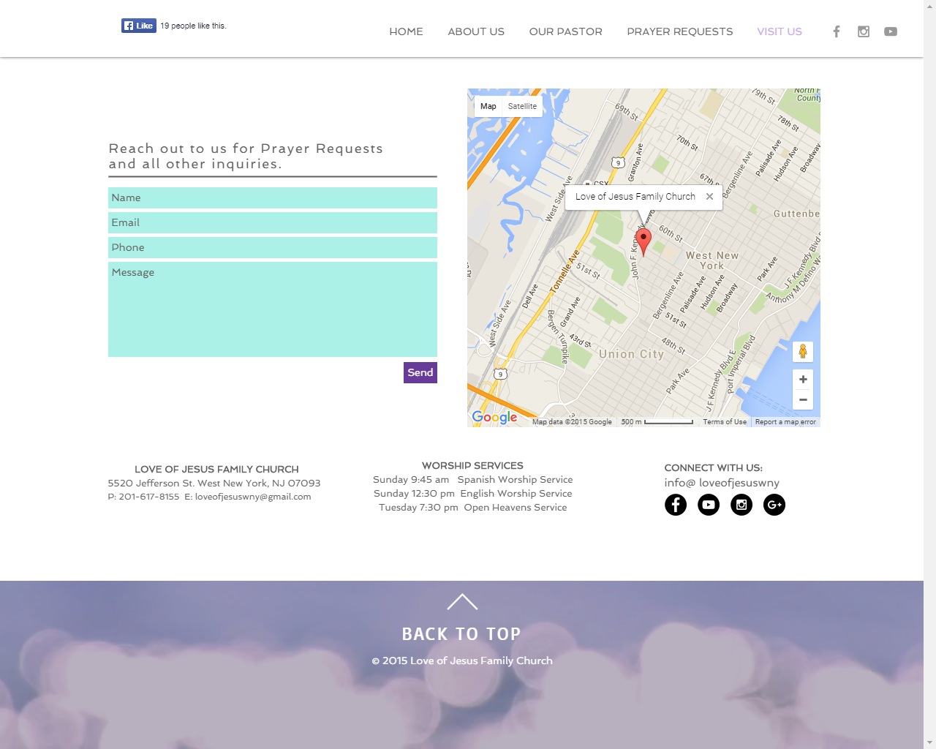

Slide 19
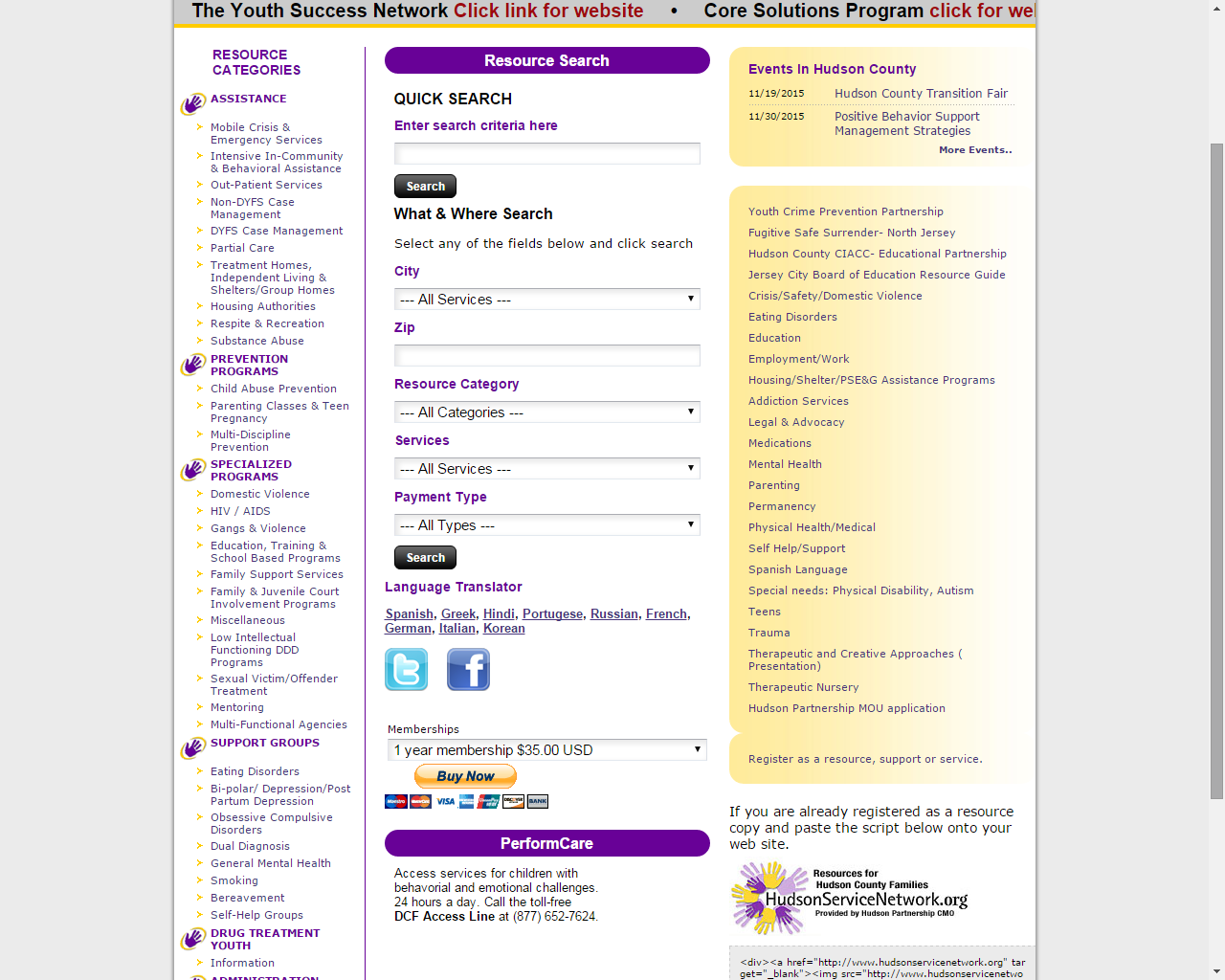

Slide 20
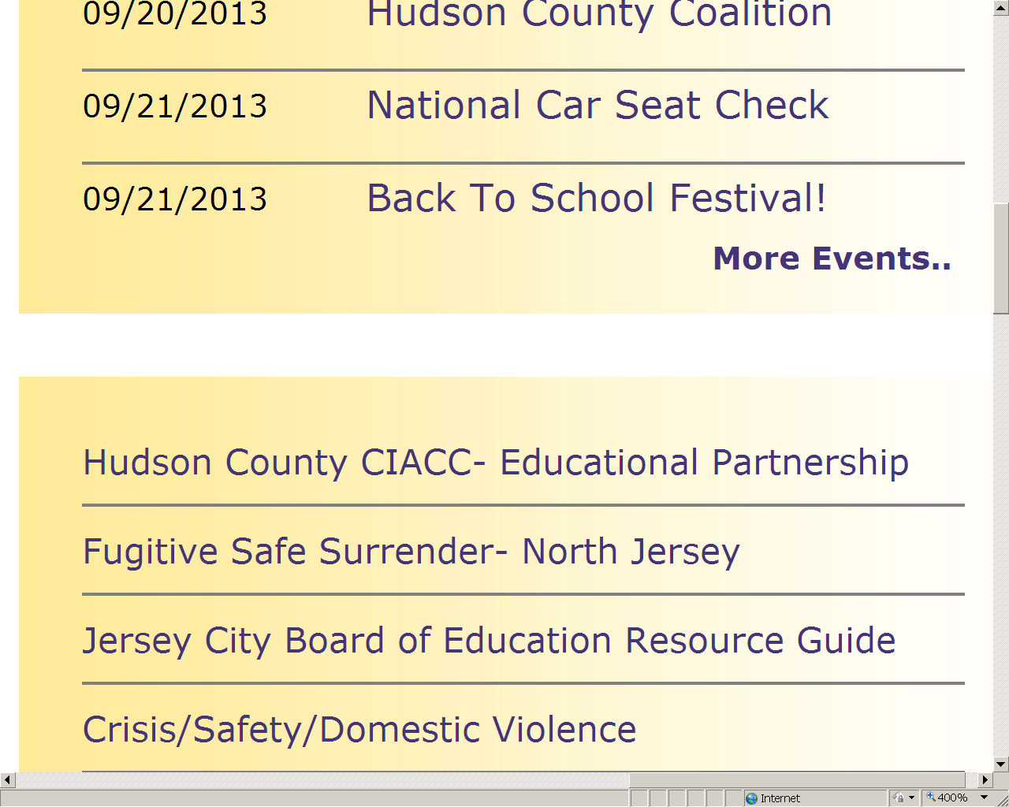

Slide 21
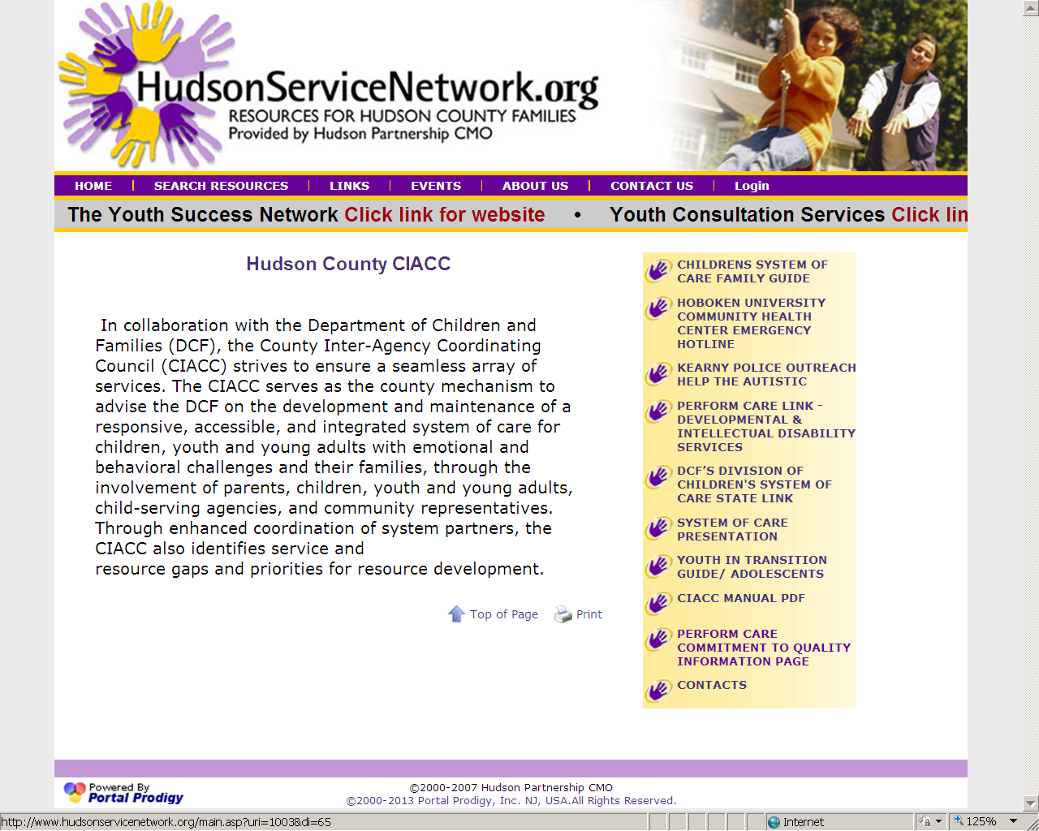

Slide 22
Contact Us
Perform Care 1-877-652-7624
Mobile Response , CMRSS
Patricia Valdivia, LCSW 201-798-7452
Hudson Partnership CMO
Steven Campos 201 537 1429 or e- scampos@hudsoncmo.org
  Hudsonservicenetwork.org
  CIACC Coordinator Samantha Moore Phone: (201) 369-5280 ex. 4241
Family Partners Hudson County FSO&
Youth Partnership of Hudson County
  Gloria Rivera 201-915-5140
  CIACC Coordinator
  Phone: 201-369-5280 ext. 4238

